Slide 1
Safety of Formula 1, looking at the first straight and turn
Kevin Wilbrink (6310621) and Jordi Wippert (6303013)
Notes:
Kevin

Slide 2
Content
Problem introduction
Nagel-Schreckenberg model
Adjusted model
Simulation
Results and conclusion
Discussion
Notes:
Kevin

Slide 3
Problem introduction
Formula 1
Safety
How can we improve the safety of Formula 1 by looking at the first straight and turn?
Notes:
Jordi

Slide 4
Nagel-Schreckenberg model
Acceleration
Slowing down
Randomization
Car motion
Notes:
Kevin

Slide 5
Adjusted model
Circuits
Startgrid
Multiple rows
Turn
Notes:
Kevin

Slide 6
Adjusted model (2)
Accelerating
Braking
Overtaking
Defending
Optimal line
Notes:
Jordi

Slide 7
Adjusted model (3)
Last moment switch
Crash/brake
Random number
Notes:
Jordi

Slide 8
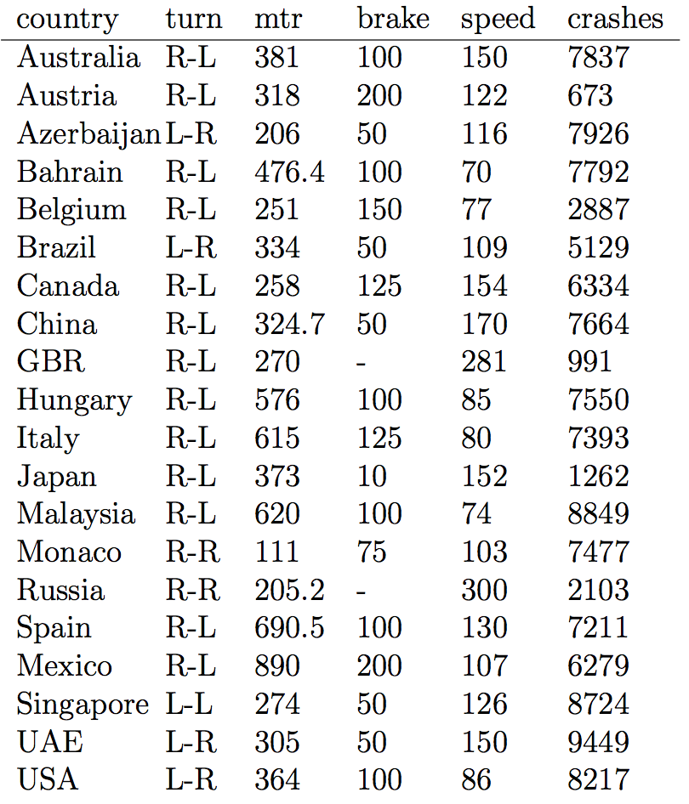
Simulation
10,000 runs for each track
121,747 crashes
Notes:
Kevin

Slide 9
Results
Real-world
Notes:
Kevin

Slide 10
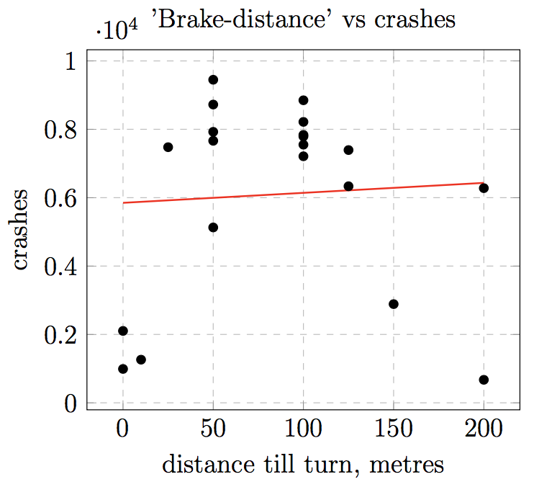
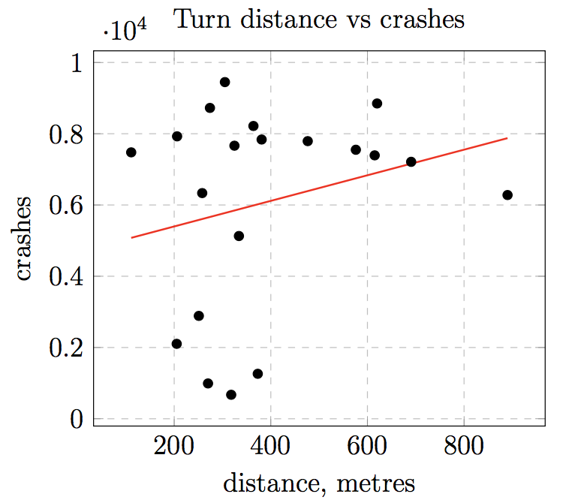
Results (2)
Notes:
Jordi

Slide 11
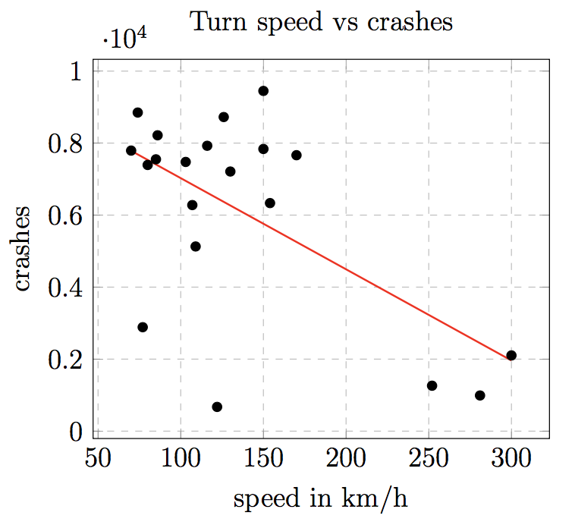
Results (3)
Brake distance
Turn distance
Turn speed
Notes:
Kevin

Slide 12
Discussion
Future model improvements
Acceleration
Rows
Crashes
Notes:
Jordi

Slide 13
Our research shows that there’s no significant indication to change (brake) distances, while safety seems to be improved by driving at higher speeds in turn one.
Notes:
Kevin

